Slide 1
Raster Displays and NumPy Intro
CSCI 4150/6050: Computer Vision
Slides Credit: Dr. Bryan Morse from BYU

Slide 2
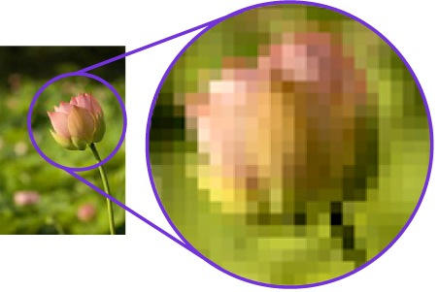
Raster Images
Most digital displays are made up of discrete dots
called “pixels” (short for picture elements)

Slide 3
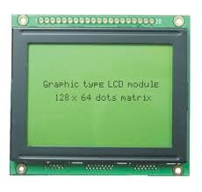
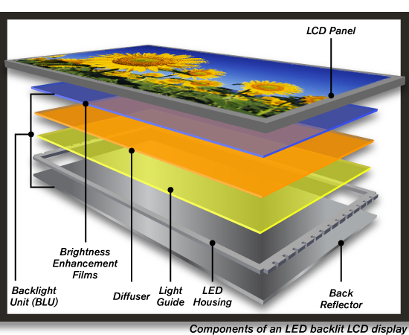
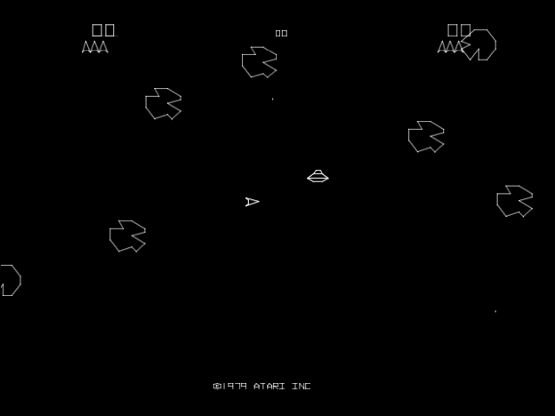
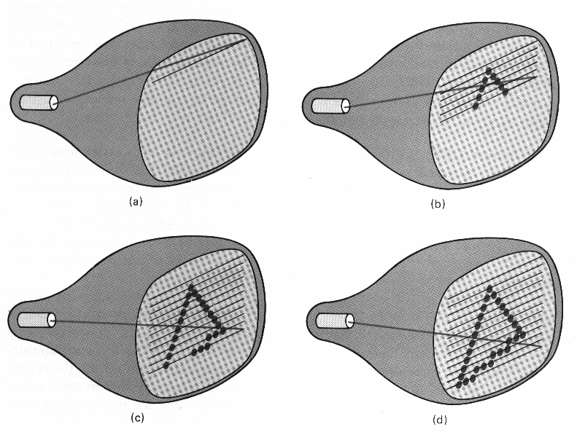
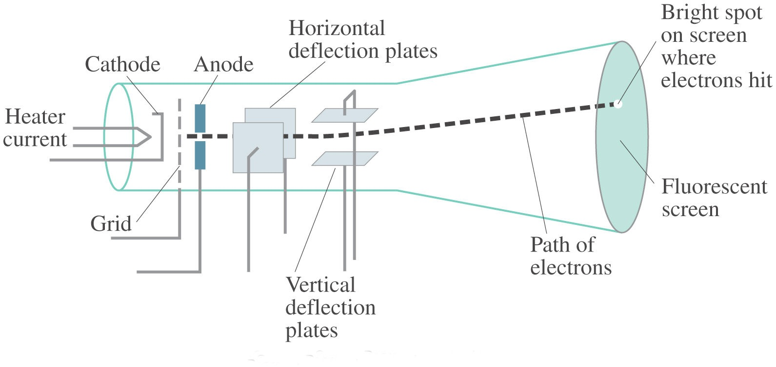
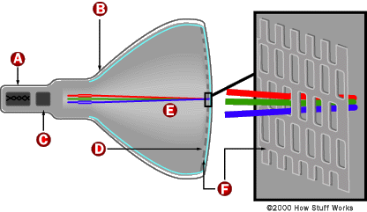
Quick History
Vector graphics
Raster (CRT)
Raster (Digital)
LEDs with different light panels to produce the image.

Slide 4
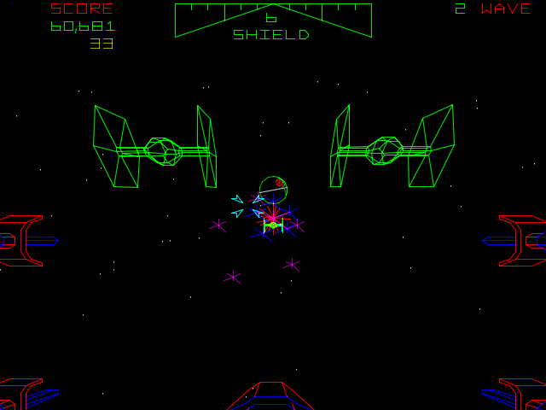
Vector Displays
Vector draws individual shapes as if drawing on a paper
https://arcadeblogger.com/2017/06/16/atari-star-wars-arcade-cockpit-development/

Slide 5
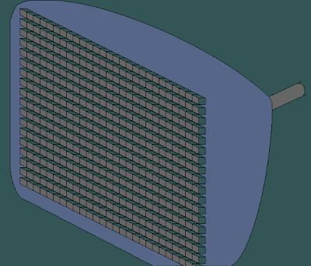
CRT Raster Displays
Cathode ray tube does line for line across the screen tilll the shape is out usind different colors.
For each pixel theres a value for red, blue and green to give a final color.
A line is skipped and then filled on the second round. Only disadvantage is if image is moving, then it looks a bit weird. - Interlacing
https://msys-mv.blogspot.com/2010/11/understanding-basic-requirements-to.html

Slide 6
Interlacing
A line is skipped and then filled on the second round. Only disadvantage is if image is moving, then it looks a bit weird.
Progressive
  Full screen 60 frames / second
Interlaced
  Half screen fields 60 times / second
    Odd lines, then even lines…
  Equivalent of 30 frames/second

Slide 7
Raster Images
Size: number of pixels (height x width)
Bit depth: bits of precision for each pixel
  Binary (true black and white)
  2-bit gray (4 shades)
  8-bit gray (256 shades)
  12-bit gray (X-rays / CT)
  24-bit color (8 bits each of R, G, B)

Slide 8
Common Display Sizes
Standard definition – dv players
HD – high definition
4k isnt really an upgrade as it uses row value 4096 instead of row as the others. The column only increased by 1k

Slide 9
How you display pictures isn’t how you have to store them!

Slide 10
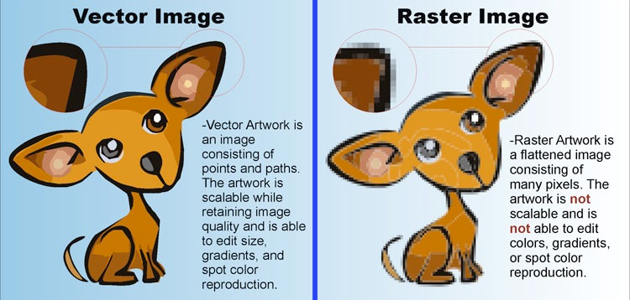


Raster vs. Vector Graphics
Best for logos as you just define image and it retains quality. But less flexible because you cannot edit individual pixels as in raster images
With raster displays, increasing the size decreases the quality as same resolution remains from start to finish.
Adobe
Illustrator
Adobe
Photoshop
Vector:
Continuous Curves
Raster:
Lots of dots

Slide 11
Rasterization
Vector graphics are higher quality
But everybody uses raster displays
Have to convert to a raster image first
(But get to target resolution to device!)
This process is called rasterization
(sometimes scan conversion)

Slide 12
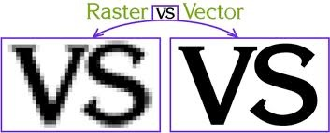
Example: Text
Most fonts aren’t stored as bitmaps (images)
Stored instead as curves representing the outline of the characters
Converted to whatever resolution device supports

Slide 13
Example: Postscript
When you send a Postscript file to a printer,
  You aren’t sending a picture of what to print (usually)
  You are sending a program for how to print it

Slide 15
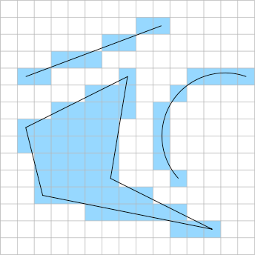
What Could Possibly Go Wrong?
Which are in?
Which are out?
Vectors have continuous variables ie floating points, so rasterisation is difficult as values are discrete so as seen the shape in blue is vector and black layout is raster
Aliasing
“Jaggies”

Slide 16
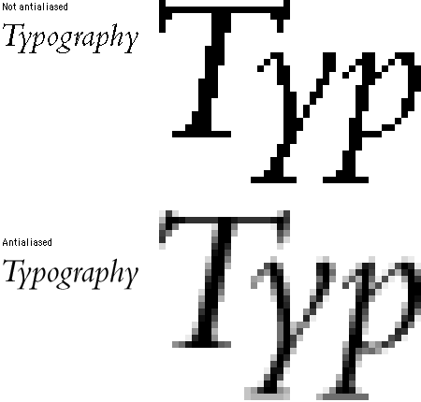
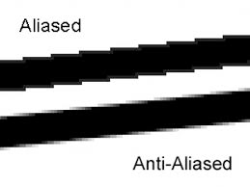
Antialiasing
Can make it look much sharper by blurring a bit
(no, really!)
Key: partially fill in pixels during rasterization
Solution is bluring as it looks good in the smaller font, because our eyes get light from differentt sources and fill in the blank better.

Slide 17
Layers upon layers...
In most systems there are lots of layers:
  Drawing API
  GUI
  OS
  Screen Buffers
  Graphics drivers
  Graphics cards
  Display

Slide 18
Let’s talk more about NumPy…

Slide 19

What is NumPy?
NumPy is matrix and tensor processing library for Python.
Features include:
  Coinvent and fast array processing
  High-level math functions
Very similar to MATLAB functionality
Numerical Python
import numpy as np

Slide 20
How do you make a Numpy array?
Options:
  Write it out in full
    np.array([[1,2,3],[4,5,6],[7,8,9]])
  Make an array of zeros of the desired shape and size
    np.zeros((num_rows,num_cols,num_ch),dtype=np.float32)
  Load in an image/external data
  And many more…
$\left[\begin{matrix}1 & 2 & 3 \\ 4 & 5 & 6 \\ 7 & 8 & 9\end{matrix}\right]$
Ie blank image, eg 1000 rows, 2000 cols and 3channels.

Slide 21
Vectorization
The most powerful aspect of NumPy is the ability for NumPy to apply operations to all the elements of the array at the same time. This is called vectorization.
  Slow:
for i in range(rows):
for j in range(cols):
arr[i,j] += 1
  Fast: numpy already lays out the entire matrix and knows all postions.
  Adding a value to the image is increasing its brightness as the image values move towards white.
arr += 1
For loop is slow because the I and j variables keep going back and forth memory to check location to the matrix values and do calculations.
$\left[\begin{matrix}1 & 2 & 3 \\ 4 & 5 & 6 \\ 7 & 8 & 9\end{matrix}\right]$
$\left[\begin{matrix}2 & 3 & 4 \\ 5 & 6 & 7 \\ 8 & 9 & 10\end{matrix}\right]$

Slide 22
Vectorized Math Operations
Addition/Subtraction : arr + num or arr - num
Multiplication/Division : arr * num or arr / num
Elementwise Addition: arr1 + arr2
Elmentwise Multiplication: arr1 * arr2
Matrix Multiplication: arr1 @ arr2
Math Functions: np.cos(arr1), np.linalg.norm(arr1), …

Slide 23
Broadcasting
NumPy can perform vectorized operations if the operation properly broadcasts between the two pieces of data. If it doesn’t, the code cannot run.
This usually means that the two NumPy arrays have the same number of rows, columns, channels, etc.
Other configurations that can (usually) broadcast are
  Scalar and a NumPy Array
  Vector to a Matrix (1D to 2D Tensor)
  Grayscale image to a Color Image (2D to 3D Tensor)

Slide 24
Let’s look at a speed test between Python for loops and vectorization with NumPy…

Slide 25
Indexing
Usually, we will work with images a whole, but if you ever need to access specific parts of an image, NumPy arrays are zero-indexed for each dimension separately.
For images, NumPy arrays are usually indexed by row, then column, then color channel.
  arr[row, col, ch]
Example, arr[10,15,1] would return the the value in the 11th row, 16th column, and 2nd color channel.
$\left[\begin{matrix}5 & −3 & 1 \\ 4 & 5 & 0 \\ 7 & 8 & 2\end{matrix}\right]$
row
$\left[\begin{matrix}4 & 8 & −7 \\ 4 & 5 & 15 \\ 7 & 8 & 11\end{matrix}\right]$
$\left[\begin{matrix}1 & 2 & 3 \\ 4 & 5 & 6 \\ 7 & 8 & 9\end{matrix}\right]$
ch
col

Slide 26
Slice Notation
You can also grab chunks of an image at a time using NumPy slide notation.
  arr[start:stop:step]
  start: First element to include
  stop: First element to exclude (not last element to include)
  step: Step size for grabbing pixels
  “:” indicates grab everything in that dimension

Slide 27
Slice Notation Examples
  arr[5:12:1,:,:] – Grab every pixel in rows 5 through 11
  arr[:,3:16:2,:] – Grab every other column between 3 and 15.
  arr[:,:,0] – Grab every row and column for the first channel.
  arr[:,:,::-1] – Reverse the order of the color channels.
  arr[5:12] – Grab every pixel in rows 5 through 11 (same as first one. Ie not mentioning the rows and channels means you’re keeping it)
  arr[7:] – Grab every row from row 7 to the end
  arr[:-4] – Grab every row except the last 4
But get all the columns and all the channels. The comma indicates the rows, col, and channel

Slide 28
Let’s try it in NumPy…

Slide 29
Coming up...
Level operations on images
  Brightness
  Contrast
  …

